Slide 1
https://www.netflix.com/watch/70069628?trackId=200257859
Start 7:35 ---- End 13:30

Slide 2


VS
Ben Cash | Live Oak Bank | 2/23/18

Slide 3




POPULARITY
PRESTIGE
PROFITABILITY
DASHBOARD

Slide 4







MV DC
Thor
83
87
2 Mill
1 Mill
1%
2014
Marvel
Batman
85
95
5 Mill
2 Mill
1.5%
2015
DC
The Avengers
90
92
4 Mill
3 Mill
0.3%
2016
Marvel
Justice League
87
85
1 Mill
2 Mill
-0.5%
2017
DC

Slide 5
POPULARITY

Slide 6
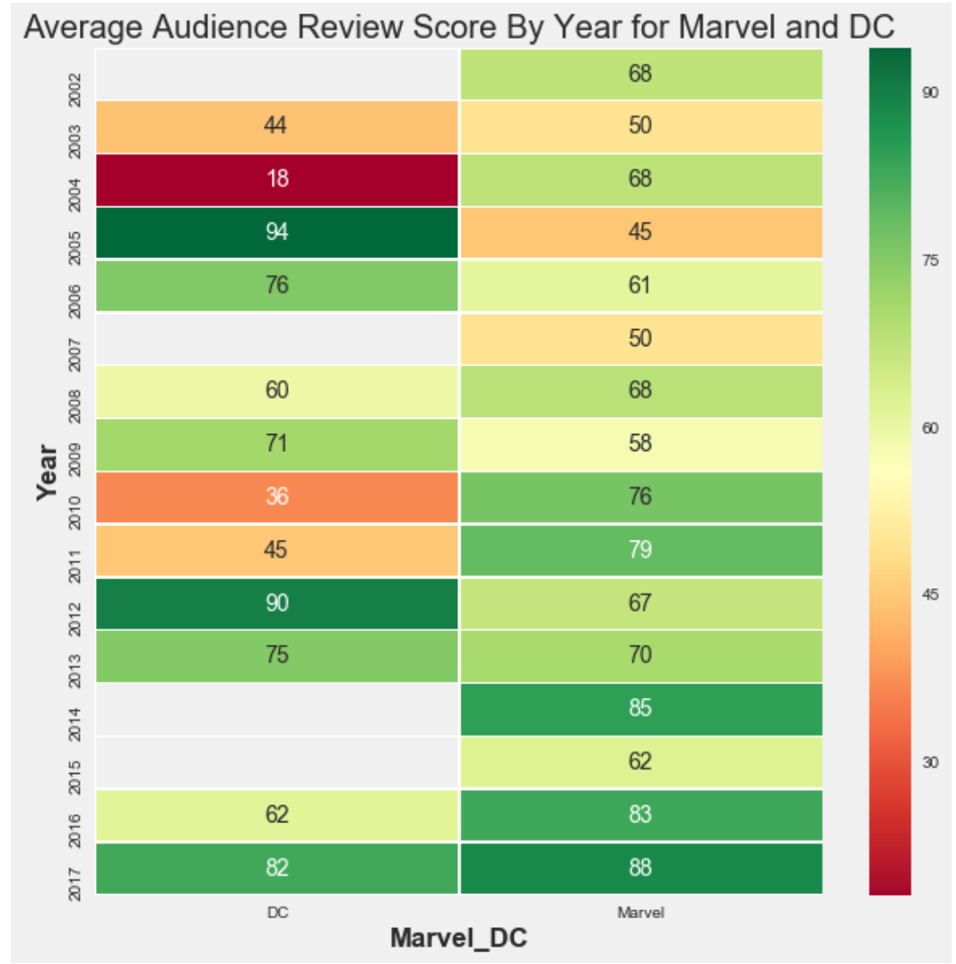




DC
MARVEL

Slide 7
POPULARITY
PRESTIGE
PROFITABILITY

Slide 8
PRESTIGE

Slide 9
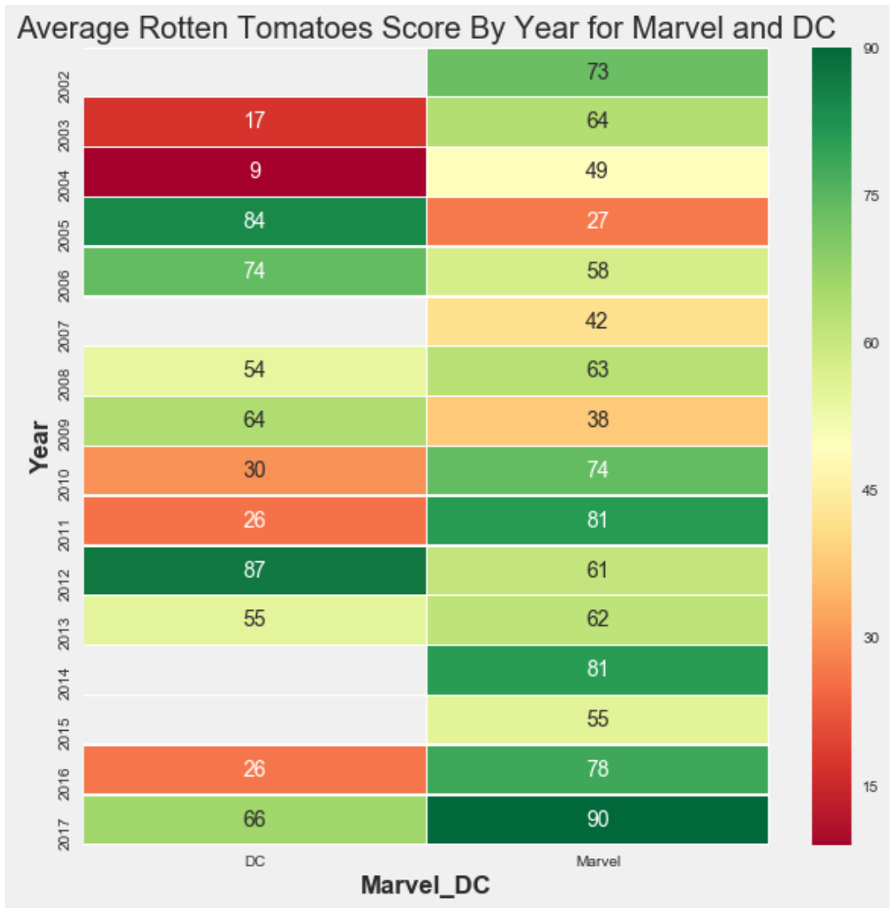

DC
MARVEL

Slide 10
POPULARITY
PRESTIGE
PROFITABILITY

Slide 11
PROFITABILITY

Slide 12
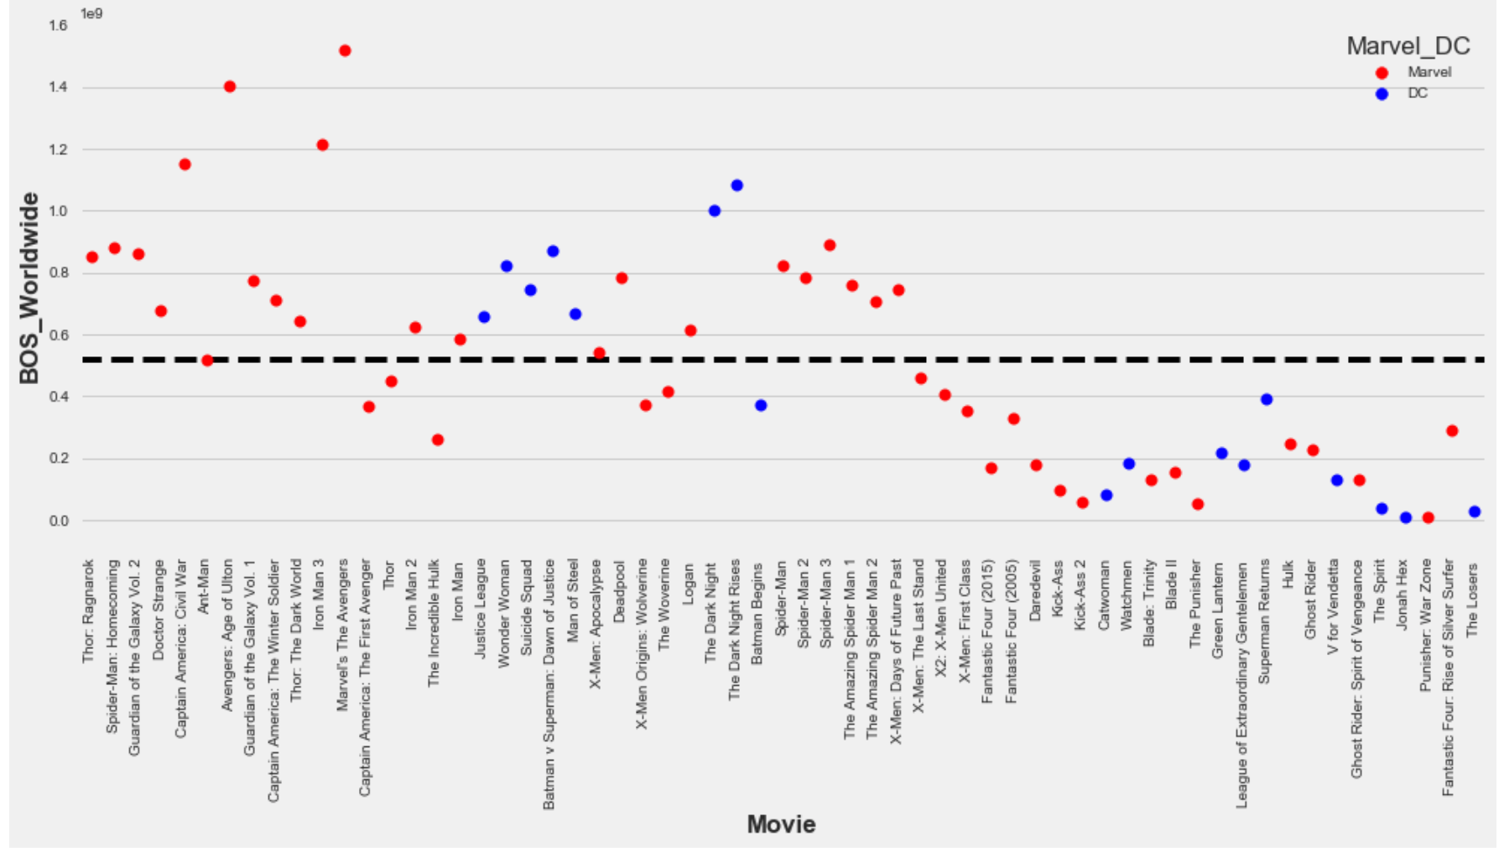
Marvel’s The Avengers
Avengers: Age of Ultron
Iron Man 3
Captain America: Civil War
The Dark Night Rises

Slide 13
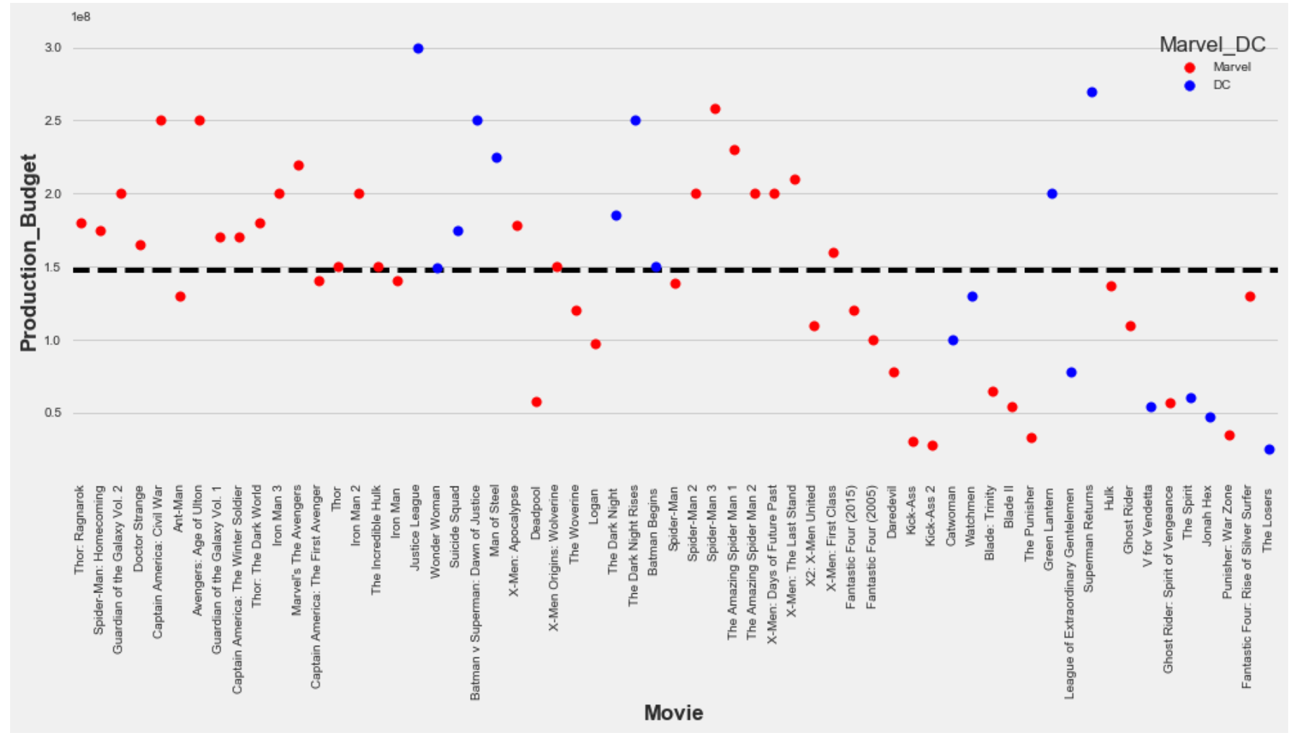
Justice League
Superman Returns
Spider Man 3
Avengers: Age of Ultron
Captain America: Civil War

Slide 14
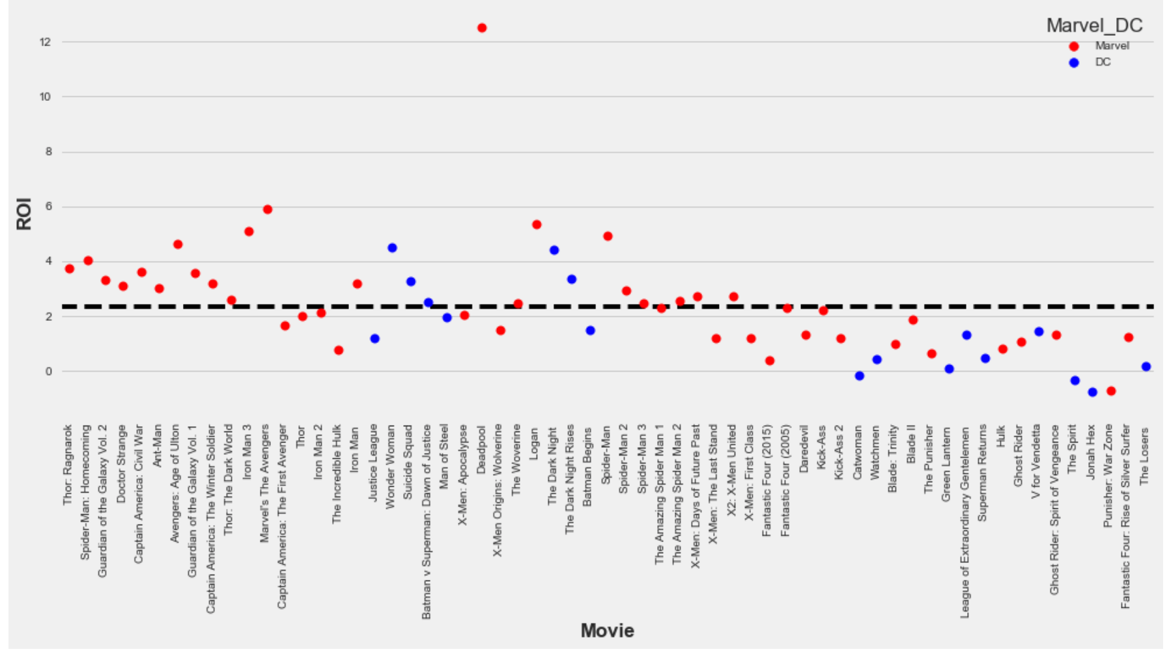
Deadpool
Marvel’s The Avengers
Logan
Iron Man 3
Spider-Man

Slide 15
Jonah Hex
Punisher: War Zone
The Spirit
Catwoman
Green Lantern

Slide 16
POPULARITY
PRESTIGE
PROFITABILITY

Slide 17
DASHBOARD

Slide 18
Link to Jupyter Notebook Marvel DC Bokeh Dashboard
http://localhost:8888/notebooks/OneDrive/Personal%20Development/Live%20Oak%20Bank/Marvel-DC-BokehDashboard.ipynb#

Slide 19

QUESTIONS

Slide 20

APPENDIX

Slide 21
Link to Jupyter Notebook Marvel DC Analysis
http://localhost:8888/notebooks/OneDrive/Marvel-DC-Analysis.ipynb#

